Slide 1
Notes:
Project Management 6e.
10–<number>

Slide 2
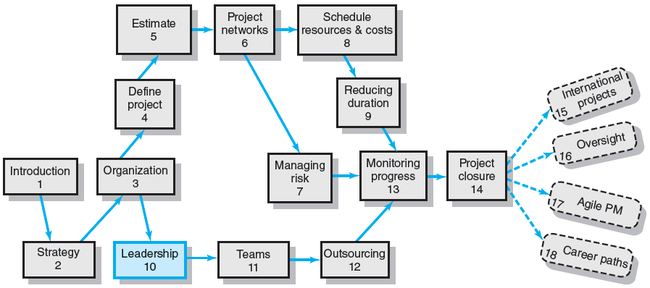
Where We Are Now
10–<number>
Notes:
Project Management 6e.
10–<number>

Slide 3

Managing versus Leading a Project
Managing—coping with complexity
  Formulate plans and objectives
  Monitor results
  Take corrective action
  Expedite activities
  Solve technical problems
  Serve as peacemaker
  Make tradeoffs among time, costs, and project scope
Leading—coping with change
  Recognize the need to change to keep the project on track
  Initiate change
  Provide direction and motivation
  Innovate and adapt as necessary
  Integrate assigned resources
10–<number>
Notes:
Project Management 6e.
10–<number>

Slide 4
Managing Project Stakeholders
Project Management Maxims:
  You can’t do it all and get it all done
    Projects usually involve a vast web of relationships.
  Hands-on work is not the same as leading.
    More pressure and more involvement can reduce
    your effectiveness as a leader.
  What’s important to you likely isn’t as important
  to someone else
    Different groups have different stakes (responsibilities, agendas, and priorities) in the outcome of a project.
  Remember: project management is tough, exciting, and rewarding—endeavor to persevere.
10–<number>
Notes:
Project Management 6e.
10–<number>

Slide 5
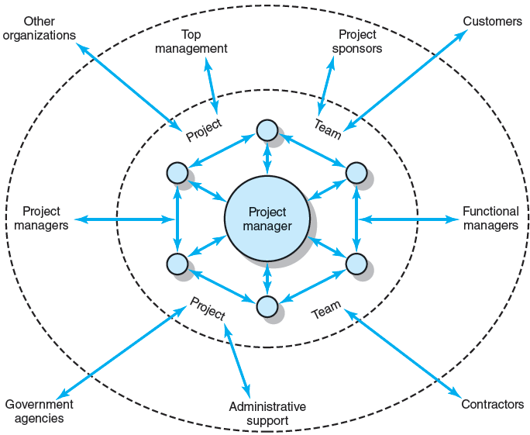
Network of Stakeholders
FIGURE 10.1
10–<number>
Notes:
Project Management 6e.
10–<number>

Slide 6
Influence as Exchange
The Law of Reciprocity
  One good deed deserves another, and
  likewise, one bad deed deserves another.
Quid pro Quo
  Mutual exchanges of resources and services
  (“back-scratching”) build relationships.
Influence “Currencies” (Cohen and Bradford)
  Cooperative relationships are built on the exchange
  of organizational “currencies” (favors).
10–<number>
Notes:
Project Management 6e.
10–<number>

Slide 7
Commonly Traded Organizational Currencies
Task-related currencies
  Resources Lending or giving money, budget increases, personnel, etc.
  Assistance Helping with existing projects or undertaking unwanted tasks.
  Cooperation Giving task support, providing quicker response time, or aiding implementation.
  Information Providing organizational as well as technical knowledge.
Position-related currencies
  Advancement Giving a task or assignment that can result in promotion.
  Recognition Acknowledging effort, accomplishments, or abilities.
  Visibility Providing a chance to be known by higher-ups or significant others in the organization.
  Network/ Providing opportunities for linking with others.
  contacts
Source: Adapted from A. R. Cohen and David L. Bradford, Influence without Authority
(New York: John Wiley & Sons, 1990). Reprinted by permission of John Wiley & Sons, Inc.
TABLE 10.1
10–<number>
Notes:
Project Management 6e.
10–<number>

Slide 8
Organizational Currencies (cont’d)
Inspiration-related currencies
  Vision Being involved in a task that has larger significance for the unit, organization, customer, or society.
  Excellence Having a chance to do important things really well.
  Ethical correctness Doing what is “right” by a higher standard than efficiency.
Relationship-related currencies
  Acceptance Providing closeness and friendship.
  Personal support Giving personal and emotional backing.
  Understanding Listening to others’ concerns and issues.
Personal-related currencies
  Challenge/learning Sharing tasks that increase skills and abilities.
  Ownership/involvement Letting others have ownership and influence.
  Gratitude Expressing appreciation.
Source: Adapted from A. R. Cohen and David L. Bradford, Influence without Authority
(New York: John Wiley & Sons, 1990). Reprinted by permission of John Wiley & Sons, Inc.
TABLE 10.1 (cont’d)
10–<number>
Notes:
Project Management 6e.
10–<number>

Slide 9
Social Network Building
Mapping Dependencies
  Project team perspective:
    Whose cooperation will we need?
    Whose agreement or approval will we need?
    Whose opposition would keep us
    from accomplishing the project?
  Stakeholders’ perspective:
    What differences exist between the team
    and those on whom the team will depend?
    How do the stakeholders view the project?
    What is the status of our relationships with the stakeholders?
    What sources of influence does the team have relative
    to the stakeholders?
10–<number>
Notes:
Project Management 6e.
10–<number>

Slide 10
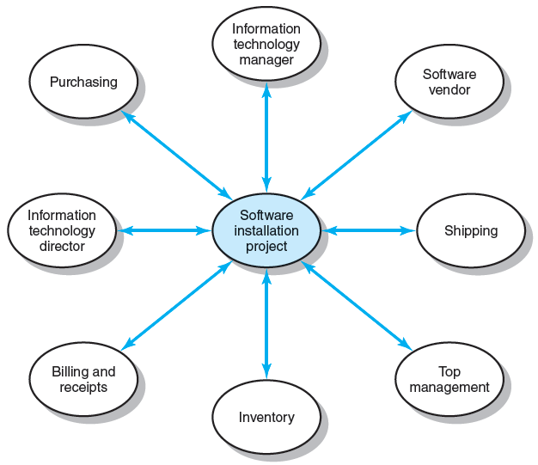
Dependencies for Financial Software Installation Project
FIGURE 10.2
10–<number>
Notes:
Project Management 6e.
10–<number>

Slide 11
Management by Wandering Around
Management by Wandering Around (MBWA)
  Involves managers spending the majority of their time in face-to-face interactions with employees building cooperative relationships.
Characteristics of Effective Project Managers
  Initiate contact with key players.
  Anticipate potential problems.
  Provide encouragement.
  Reinforce the objectives and vision of the project.
  Intervene to resolve conflicts and prevent stalemates.
10–<number>
Notes:
Project Management 6e.
10–<number>

Slide 12
Managing Upward Relations
Project Success = Top Management Support
  Appropriate budgets
  Responsiveness to unexpected needs
  A clear signal to the organization
  of the importance of cooperation
Motivating the Project Team
  Influence top management in favor of the team:
    Rescind unreasonable demands
    Provide additional resources
    Recognize the accomplishments of team members
10–<number>
Notes:
Project Management 6e.
10–<number>

Slide 13
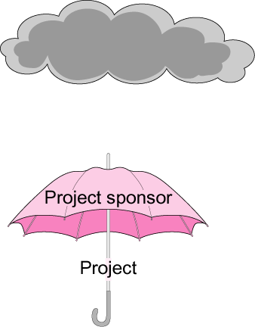
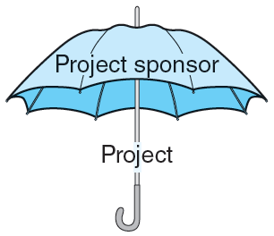
The Significance of a Project Sponsor
Upper management
FIGURE 10.3
10–<number>
Notes:
Project Management 6e.
10–<number>

Slide 14
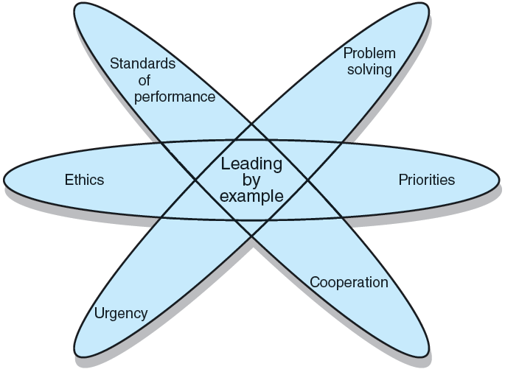
Leading by Example
FIGURE 10.4
10–<number>
Notes:
Project Management 6e.
10–<number>

Slide 15
Ethics and Project Management
Ethical Dilemmas
  Situations where it is difficult to determine
  whether conduct is right or wrong:
    Padding of cost and time estimations
    Exaggerating pay-offs of project proposals
    Falsely assuring customers that everything is on track
    Being pressured to alter status reports
    Falsifying cost accounts
    Compromising safety standards to accelerate progress
    Approving shoddy work
  Code of conduct
    Professional standards and personal integrity
10–<number>
Notes:
Project Management 6e.
10–<number>

Slide 16

Contradictions of Project Management
Innovate and maintain stability.
See the big picture while getting your hands dirty.
Encourage individuals but stress the team.
Hands-off/Hands-on.
Flexible but firm.
Team versus organizational loyalties.
10–<number>
Notes:
Project Management 6e.
10–<number>

Slide 17

Traits of an Effective Project Manager
Systems thinker
Personal integrity
Proactive
High emotional intelligence (EQ).
General business perspective
Effective time management
Skillful politician
Optimist
10–<number>
Notes:
Project Management 6e.
10–<number>

Slide 18

Suggestions for Project Managers
Build relationships before you need them.
Trust is sustained through frequent
face-to-face contact.
Realize that “what goes around comes around.”
10–<number>
Notes:
Project Management 6e.
10–<number>

Slide 19
Key Terms
Emotional intelligence (EQ)
Inspiration-related currencies
Law of reciprocity
Leading by example
Management by wandering around (MBWA)
Personal-related currencies
Position-related currencies
Proactive
Relationship-related currencies
Social network building
Stakeholder
Systems thinking
Task-related currencies
10–<number>
Notes:
Project Management 6e.
10–<number>

